Slide 1
Do fans know who the best NBA players are?
By Noel Mathew

Slide 2
Problem to Answer
The NBA is a star-driven league where fans gravitate to certain high performing players.
Those players usually generate a lot of buzz on social media platforms like Twitter, and people will buy tickets just to watch that player play, etc.
How much a players’ performance factor into if a player is considered a star

Slide 3
Who is my client
NBA Teams
If they have high performing player then can promote him to increase attendance numbers
Agents
High Performing Players who do not generate buzz
NBA itself
Can promote new players to generate buzz for the league
This will help the first two clients as well

Slide 4
Data that will be used
Basketball statistics from the 2017 season
Basic stats: points, rebounds, assists, blocks, etc.
Advanced stats: RPM, Win Share, Player efficiency, etc.
Online presence during the 2017 season
Wikipedia page views
Twitter retweets/favorites
Data set that will be used
https://www.kaggle.com/noahgift/social-power-nba.

Slide 5
Data Cleaning Steps
Combined the basic stats and advanced stats to one data frame
Basic Stats: Points, Rebounds Assists, Steals, Blocks
Advances Stats: RPM, Net Rating, Win share, Player Efficiency.
Combined online presence/buzz to one data frame
Wikipedia page views
Twitter Retweets/Favorites
Team Attendance stats (AVG/PCT)
Combined the results from above to a final data frame

Slide 6
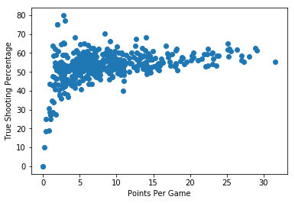
Data Story: Relationship between stats

Slide 7
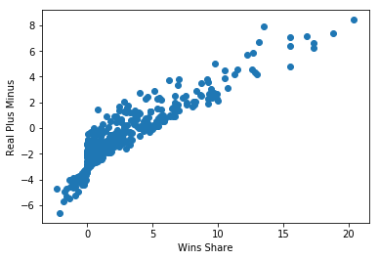

Slide 8
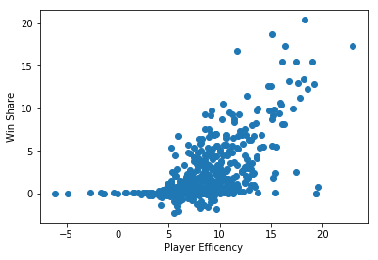

Slide 9
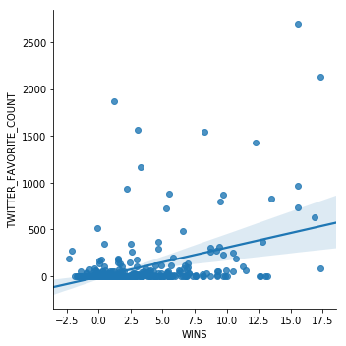
Data Story: Relationship between Stats and Presence

Slide 10
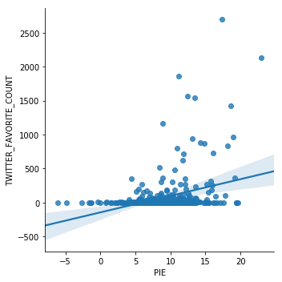

Slide 11
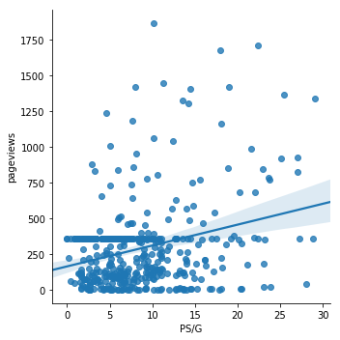

Slide 12
